Slide 1




CIT 596 MODULE 13.1
NP-completeness of Circuit Satisfiability
Sampath Kannan

Slide 2


COOK-LEVIN THEOREM
The theorem is often stated as:
Satisfiability is NP-complete.
(Satisfiability is a problem we have yet to define.)
We will sketch the proof of a similar statement first:
Circuit satisfiability is NP-complete.
Later we will define Satisfiability and show that it is also NP-complete.

Slide 3

CIRCUIT SATISFIABILITY IS NP-COMPLETE
Circuit satisfiability (CSAT) is easily seen to be in NP.
A YES-instance of CSAT is a circuit whose input variables can be set to make the circuit evaluate to a 1.
Given a YES-instance $c$ with $n$ input variables:
A good certificate is an assignment of truth values to these variables that cause $c$ to compute 1.
A verifier only has to solve the circuit value problem that (we already saw) can be done in polynomial time.

Slide 4
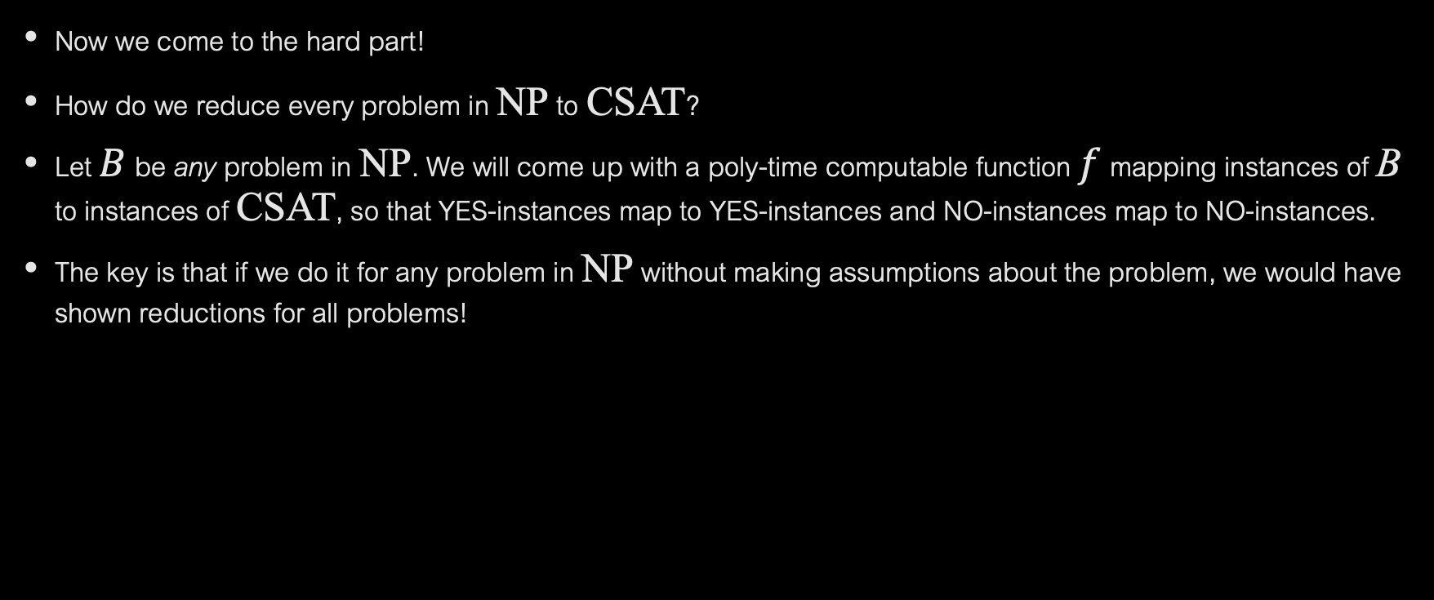
PROOF (CONTINUED)
Now we come to the hard part!
How do we reduce every problem in NP to CSAT?
Let $B$ be any problem in NP. We will come up with a poly-time computable function $f$ mapping instances of B to instances of CSAT, so that YES-instances map to YES-instances and NO-instances map to NO-instances.
The key is that if we do it for any problem in NP without making assumptions about the problem, we would have shown reductions for all problems!

Slide 5

PROOF (CONTINUED)
What do we know about any problem B in NP?
It has a poly-time verifier $V_{B}$. Remember that $V_{B}$ takes two inputs: an instance $x$ and a certificate $y$.
The reduction $f$ that we construct will closely depend on $V_{B}$.
$f$ must take as input an instance of B, say $x$, and convert it to an instance of CSAT, $f(x)$, with the answer-preserving properties of a reduction.

Slide 6
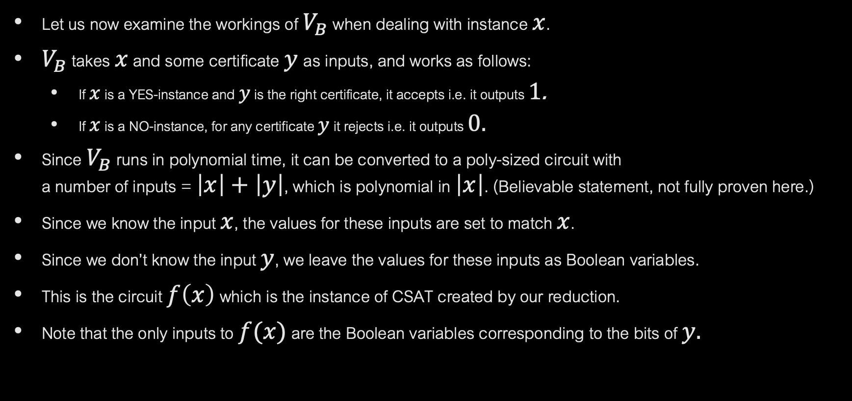
PROOF (CONTINUED)
Let us now examine the workings of $V_{B}$ when dealing with instance $x$.
$V_{B}$ takes $x$ and some certificate $y$as inputs, and works as follows:
If $x$ is a YES-instance and $y$ is the right certificate, it accepts i.e. it outputs 1.
If $x$ is a NO-instance, for any certificate $y$ it rejects i.e. it outputs 0.
Since $V_{B}$ runs in polynomial time, it can be converted to a poly-sized circuit with a number of inputs = $\left|x\right|+\left|y\right|$, which is polynomial in $\left|x\right|$. (Believable statement, not fully proven here.)
Since we know the input $x$, the values for these inputs are set to match $x$.
Since we don’t know the input $y$, we leave the values for these inputs as Boolean variables.
This is the circuit $f\left(x\right)$ which is the instance of CSAT created by our reduction.
Note that the only inputs to $f(x)$ are the Boolean variables corresponding to the bits of $y.$

Slide 7
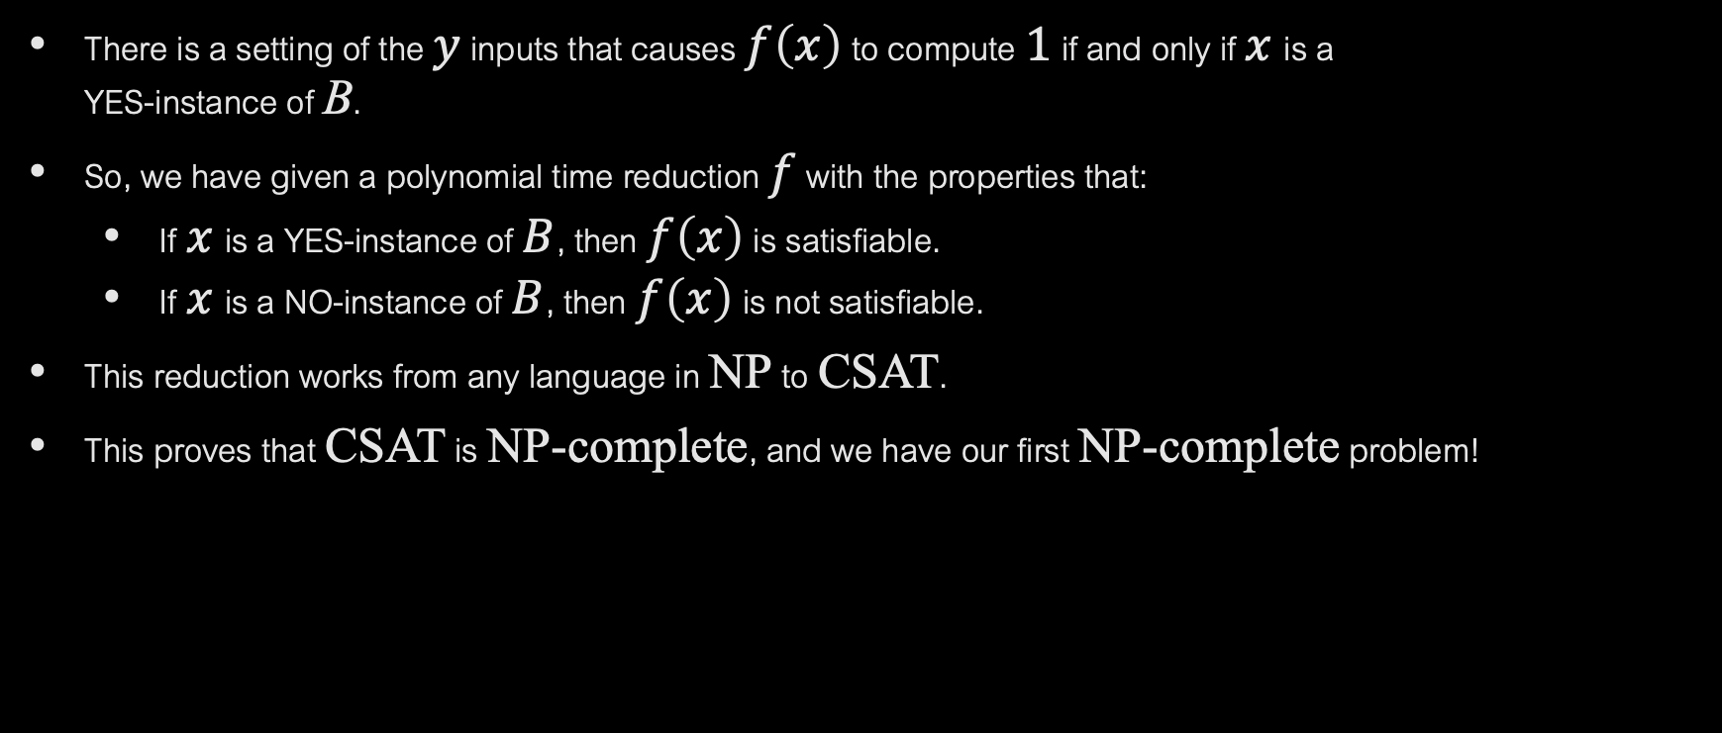
PROOF (CONTINUED)
There is a setting of the $y$ inputs that causes $f\left(x\right)$ to compute 1 if and only if $x$is a YES-instance of B.
So, we have given a polynomial time reduction $f$ with the properties that:
If $x$is a YES-instance of $B$, then $f\left(x\right)$ is satisfiable.
If $x$is a NO-instance of $B$, then $f\left(x\right)$ is not satisfiable.
This reduction works from any language in NP to CSAT.
This proves that CSAT is NP-complete, and we have our first NP-complete problem!

Slide 8

BOOLEAN FORMULAS
Circuits are messy to reason with; it’s nicer to work with Boolean formulas.
Boolean variables take values 0 or 1.
Variables like $x, \overline{x}$ are called literals.
An OR of literals such as $(\overline{x}+y+\overline{z}$) is called a clause.
A formula in conjunctive normal form (CNF) is an AND of clauses.
A CNF formula evaluates to 1 if at least one literal in each clause is true.
Satisfiability is the problem of deciding whether a CNF formula is satisfiable.
If a formula is satisfiable, the assignment of values to variables that makes formula true is a satisfying assignment.

Slide 9



GATES TO FORMULAS: FIRST STEPS
How do we write a formula (in CNF) to express that this gate is working correctly?
Want to say $z=x∧y$ but “=“ is not a logical operator.
Can replace with $z⇔(x∧y)$, which is the same as $(z⟹$ $(x∧y)) ⋀ ((x∧y)⟹$ $z)$
But what is $A$ $⟹B$ ? It is $\overline{A}$ $∨B.$
Using this substitution, we can again rewrite as:
$\left(\overline{z} ∨\left(x∧y\right)\right) ∧ (\overline{(x∧y)}∨z)$
Using two rules of Boolean algebra: Distributive law for OR over AND, and De Morgan’s law, we simplify to: ($\overline{z}$ $∨x$ ) $∧\text{(}\overline{z} ∨y\text{ )}$ $∧$($\overline{x}$ $∨$ $\overline{y}$ $∨z$).
Check that the satisfying assignments of the last formula are all valid settings for the inputs and outputs of an AND gate.
For example, if $x=0 or y=0$, then $z$ must be 0 to satisfy the first two clauses.
But if both are 1, then $z$ must be 1 to satisfy the last clause.
$$z$$
$$x y$$

Slide 10
USING THIS IDEA
A similar derivation shows how to express that an OR gate is functioning correctly.
To convert a circuit into a formula, we introduce new variables on each of the internal wires of the circuit and tie the value of the output variable of a gate to the input variables using clauses as in the previous slide.
Exercise: think about the clauses needed to express the correct functioning of an OR gate and a NOT gate.
We will use this idea to show that satisfiability is NP-complete, thereby completing the (sketched) proof of the Cook-Levin theorem.

